Slide 1

Highway Robbers
Most of us have heard of the famous highway robber Dick Turpin
Dick Turpin was a butcher's son, born in Hempstead, Essex in 1705. He was also a violent highwayman who was executed in York, after being charged for murder

Slide 2
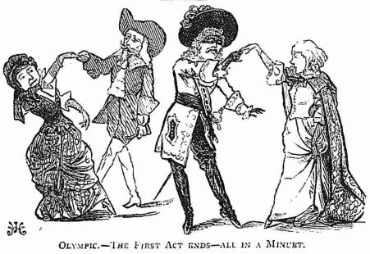
Here are some more Highway robbers
Claude Duval, also spelled Du Vall, was born in 1643, at Domfront, France
He was a gallant and courteous rogue, probably the most dashing highwayman ever to haunt the roads of England
It is rumoured that people used to hope that he would rob them because he was so handsome and polite

Slide 3
Claude Duval
Legend has it that Du Val was a bit of a fashionista who presented himself differently from your average dirty, uncouth robber
He is described as "dashing, witty and handsome," so much so that in at least one instance he agreed to steal only half of a traveller's money because the victim's wife agreed to dance with him

Slide 4
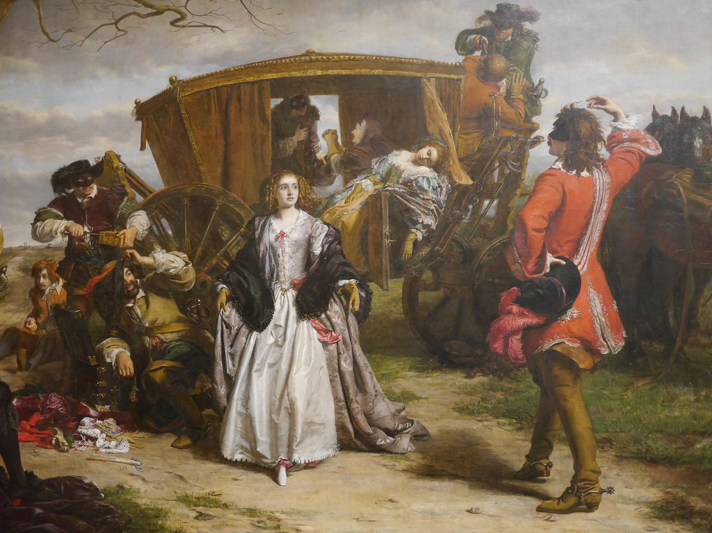
Here he is dancing with his victim

Slide 5
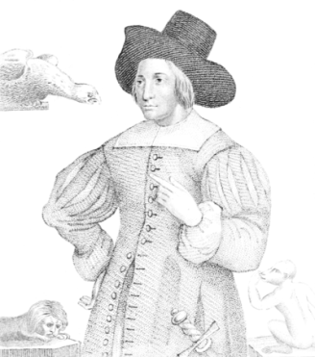
Mary Frith
Mary Frith was born around 1584.
Her father was a shoemaker near St Paul’s Cathedral
From an early age she was wild and aggressive, a ‘rumpscuttle’ or tomboy, adept with the quarterstaff and an excellent wrestler
Later she drank in taverns, smoked a pipe and wore men’s clothes. Her exploits plunged her family into despair and they tried to exile her to America, but once their backs were turned, she jumped ship and found her way back to London

Slide 6
A good businesswoman
Mary proved a proficient pickpocket, gaining the nickname of Moll Cutpurse but also turning into an astute businesswoman
She set herself up as a ‘fence’ or receiver of stolen goods, and since she was handy with her fists and could handle pistols and swords, she was somebody people didn’t meddle with
When she died, she left twenty pounds to her drinking companions, a very large sum at the time, to celebrate the restoration of the monarchy in 1660

Slide 7

Joan Bracey
Joan Bracey was born around 1656 and came from a ‘good’ family of yeomen but fell in love with a highwayman and became his common-law wife
Sometimes they rode in partnership but on occasions Joan went alone
At one such time she was surprised by the occupant of the coach she had just held up and was knocked off her horse
When she was handed over to the authorities, they were amazed to find her a woman. She was hanged at Nottingham in 1685, at the age of twenty nine

Slide 8
Activity Group B
Most highway robbers died before the age of 30
How might they be feeling once caught ?
Write an account / poem or ballad of a highwayman awaiting his fate on the gallows Use musical instruments to create the atmosphere
Play / perform this to the whole class

Slide 9
Activity Group C
Use the internet to research key facts about one of the famous highway people
Prepare a fact file or PPT presentation of them
or
Imagine that you are one of the highway robbers, write about your life and how it feels to travel the country taking valuables from unsuspecting victims
Describe your life to the whole class

